Slide 1

Women in Islam
Level 1
Mohammad Al-Bedaiwi
Austin Network for Islamic Studies ANIS http://www.AustinMuslims.org
mohammad@AustinMuslims.org

Slide 2
Topics
Concept of Gender Equality
Spiritual Equity
Social Equity
Economic Equity
Political Equity
Dress Code and Conduct

Slide 3
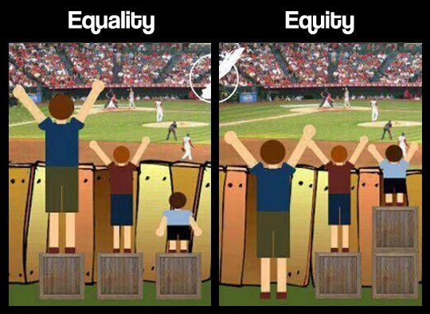
Gender Equity
Equality or Equity/Fairness

Slide 4
Gender Equity
Islam Recognize that Men and Women are different
Promoting gender equity
  Balanced and complimentary relationship
  Not Competitive
Islam vs Culture
  Muslims come from many different cultures.

Slide 5
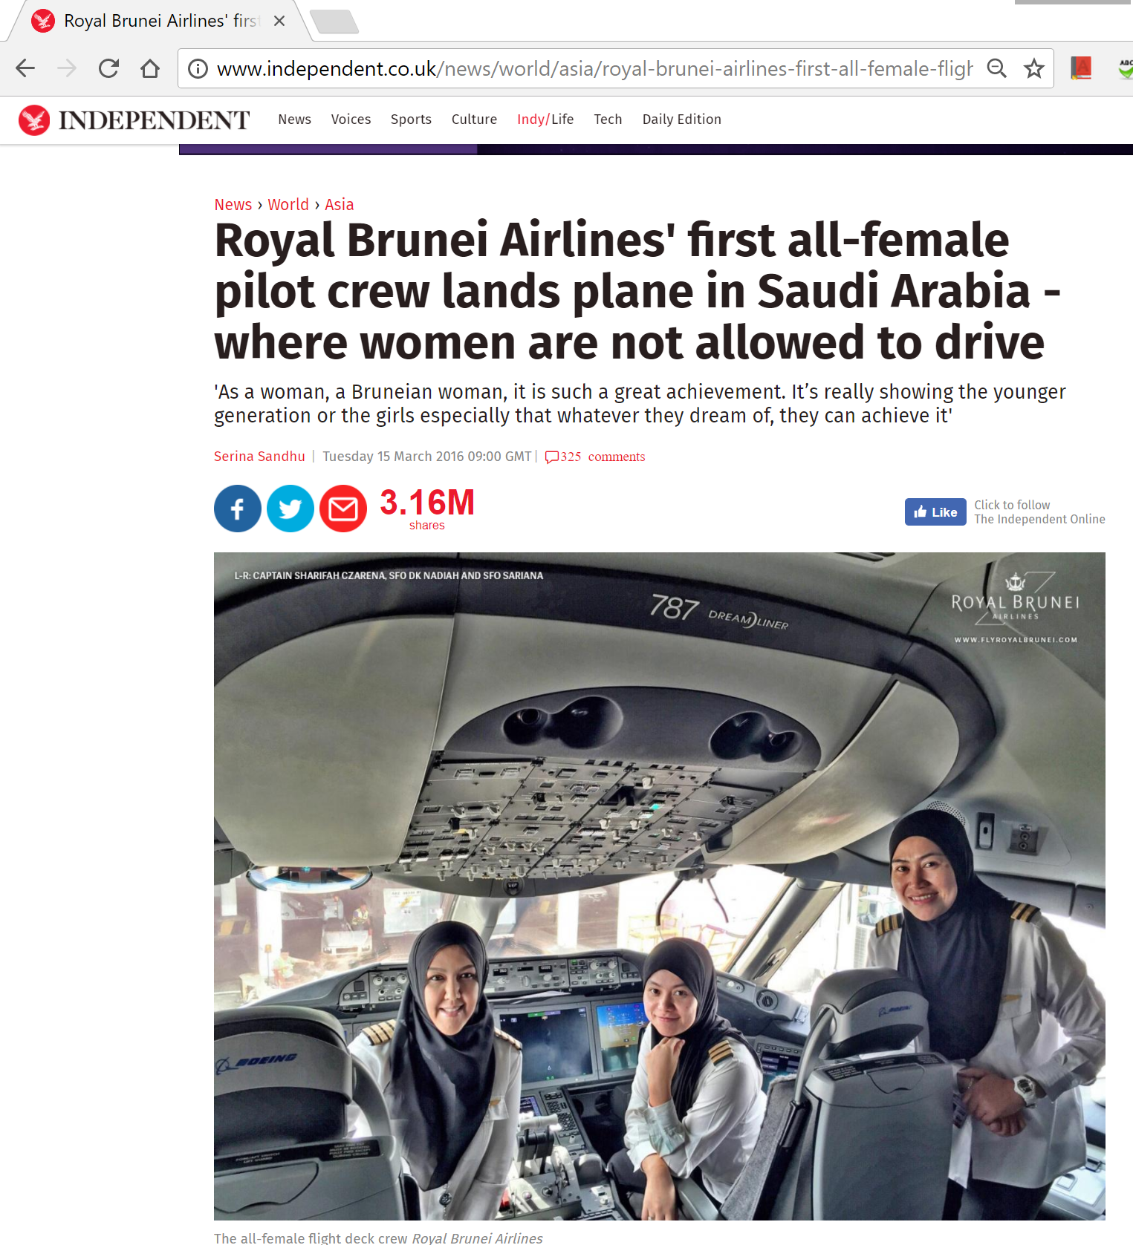

Slide 6
Spiritual Equity
Quran: Men and Women has same spiritual nature
  O mankind! Be dutiful to your Lord, Who created you from a single person (Adam), and from him (Adam) He created his wife [Hawwa (Eve)], and from them both He created many men and women and fear Allah through whom you demand your mutual (rights), and (do not cut the relations of) the wombs (kinship). Surely, Allah is Ever an All-Watcher over you.(4:1)

Slide 7
Spiritual Equity
If any do deeds of righteousness, be they male or female, and have faith, they will enter paradise and not the least injustice will be done to them.” (Quran 4:124)
Lo! Men who surrender unto Allah, and women who surrender, and men who believe and women who believe, and men who obey and women who obey, and men who speak the truth and women who speak the truth …and men who are humble and women who are humble, and men who give alms and women who give alms, and men who fast and women who fast, and men who guard their modesty and women who guard (their modesty), and men who remember Allah and women who remember-Allah has prepared for them forgiveness and a vast reward. (Quran 33:35).

Slide 8
Spiritual Equity
Qur'an addresses both men and women (not common in religious texts).
The religious obligations of prayer, fasting, charity and pilgrimage are the same.
The moral obligations are the same as well (righteousness, truthfulness, justice, chastity etc.)
Paradise is attainable for women and men alike

Slide 9
Spiritual Equity
Certainly has Allah heard the speech of the one who argues with you, [O Muhammad], concerning her husband and directs her complaint to Allah . And Allah hears your dialogue; indeed, Allah is Hearing and Seeing. (Quran 58:1)
Khawlah bentu Thalabah and Omar

Slide 10
Adam and Eve
The Qur'an frees women from the accusation of causing the downfall of man.
Eve is not singled out as guilty for the sin of Adam. (Qur'an 7:19-27)
They both sinned, both repented and were both forgiven. There's no “original sin” concept in Islam.
Women aren't evil and pregnancy and childbirth are not our punishment.

Slide 11
Social Equity
The daughter
Qur'an prohibited female infanticide (“gendercide” is still practiced in many parts of the world)
Qur'an rejected parents negative attitudes towards girl children instead of boys. Islam made fair treatment of them obligatory.
"Whosoever has a daughter and he does not bury her alive, does not insult her, and does not favor his son over her, Allah will enter him into Paradise." [Ahmad]
"Whosoever supports two daughters till they mature, he and I will come in the day of judgment as this (and he pointed with his two fingers held together)." [Ahmad]

Slide 12
Social Equity
The Wife
Marriage in Islam is based upon mutual peace, love and compassion. Its not just a means to fulfill a mans needs.
Marriage is an act of worship as well as a transaction/contract between individuals...therefore it is guided with divine advice, rights and obligations.
Islam does not encourage celibacy or monasticism as this may conflict with the nature of humans, rather Islam teaches that one of the means to perfect ones faith are through marriage and that this is the nucleus of every society.

Slide 13
Social Equity
The Wife
    And among His Signs is that He created for you mates from among yourselves that you may dwell in tranquility with them and He has put love and mercy between your (hearts); verily in that are signs for those who reflect. (Qur'an 30:21)
    "I command you to be kind to women …" (farewell sermon of prophet Muhammad)
    "The best of you is the best to his family (wife) "

Slide 14
Rights of Woman in Marriage
Right to accept or refuse any proposal
  Arranged Marriages must be approved by the couple.
The woman's consent is required for marriage
Prohibition to buy, sell or inherit women
Right to maintain her own name (she is not husbands' property)
Right to dowry
Right to full maintenance from husband
  The man is responsible pays all household expenses

Slide 15
Rights of Woman in Marriage
Right to create her own marriage conditions - (career, educational pursuits, monetary allowance, parental care etc.)
Right to separate living space
  i.e ask to live in a different home than the mans family home.
  No, it does not mean a different room in the house :)
Right to divorce
Right for divorced women and widows to remarry
Rights in maintenance during divorce
Rights in custody
Rights to retain her own property and some of that acquired within marriage
  In the USA, a woman could not get her own Credit Card till 1974

Slide 16
The Social Aspect
The Mother
Islam views kindness to parents as next to the worship of Allah.
Especially true for the mother. The mother is not just a “vessel”, she is honored and dignified in that role.
  This does not imply that is the only role of women, nor that women without children are without value.
Show gratitude to Me and to your parents: to Me is (your final) destiny." (Quran 31:14)
"And we have enjoined upon man (to be good) to his parents: His mother bears him in weakness upon weakness..." (Qur'an 31:14) (See also Qur'an 46:15, 29:8).
Your mother, your mother, your mother - then your father!

Slide 17
The Social Equity
Education
  Seeking knowledge is a right and duty of every Muslim, male and female.
  Women attended the sermons of the prophet and learned directly from him
  By the end of the prophets life there were many female scholars. The greatest scholar of Islam is the prophets wife, Aisha

Slide 18
The Economic Equity
Islam gave women rights to inheritance.
In the 7th century, Islam gave women rights to their own property before and after marriage (this did not happen until the 19th and 20th centuries in Europe and America)
Islam entitled women to be financially maintained by men (husband, father, brother)
  Not responsible for bills and household responsibilities, regardless of her wealth
Women were given the right to acquire income and keep all money they make

Slide 19
The Political Aspect
Justice is gender-less in Islam, the laws of society apply to men and women alike.
Political rights for women:
    Right to vote,
    Right to participate in political affairs
    Right to participate in public affairs
    Rights to leadership positions
  August 18, 1920
    Ratified on August 18, 1920, the 19th Amendment to the U.S. Constitution granted American women the right to vote—a right known as woman suffrage

Slide 20
Dress Code & Conduct
Both men and women dress modestly and dignified
Modesty brings honor and integrity to a society
Modesty promotes balance in a society as to prevent it from lewdness, exploitation and being overly sexualized.

Slide 21
What is hijab
Hijab in Arabic means to conceal or hide from view
Hijab is not exclusively the head covering for women
  Hijab is an attitude before it’s a dress code.
Hijab applies to men and women-but is different in appearance
Hijab includes modesty in speech, manners and behavior

Slide 22
What is hijab
"Say to the believing men that they should lower their gaze and guard their modesty......And say to the believing women that they should lower their gaze and guard their modesty; that they should not display their beauty and ornaments except what ordinarily appear thereof; that they should draw their veils over their bosoms...." (24:30,31).

Slide 23
What is hijab
The verse advising hijab addresses men first. So it does not unnecessarily burden women to maintain modesty in society alone.
Hijab is a means to protect the honor of a person
Hijab for women, is a means to place aside a woman's sexuality. It allows her personality, intelligence, character to define who she is. Her femininity is not limited to or equated with her sexuality or appearance.
Hijab allows a woman to have control over who is allowed to see her body.

Slide 24
What is hijab
  Important Points about Hijab
    It is a revelation in Qur'an, taken simply as good advice that is beneficial for the individual and society as a whole.
    Clothing should not be revealing, or transparent.
    The head-covering is a part of hijab for women
    Men cannot wear gold or silk
  Hijab – like all other obligations, one must choose to wear it freely and by choice.

Slide 25
Who wears hijab
The concept of hijab is not actually exclusive to Muslims. It may appear differently in other traditions but generally speaking the concept is the same in that it is a sign of honor, and humility in reverence to The Almighty.

Slide 26
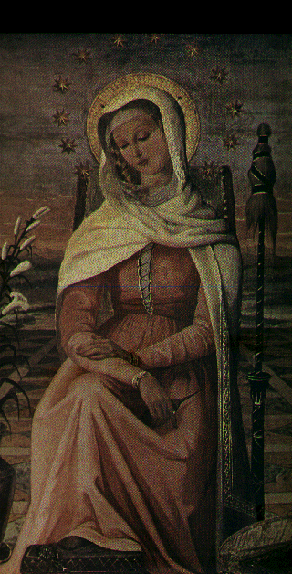
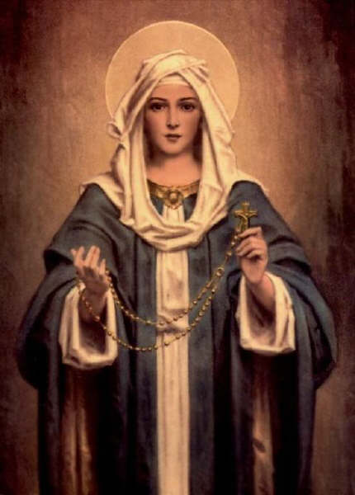
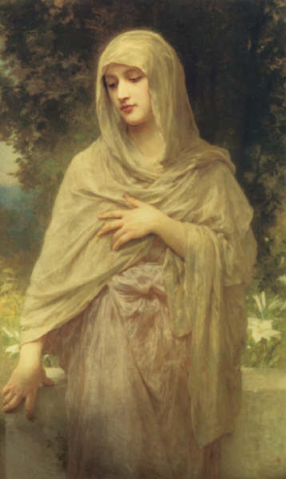
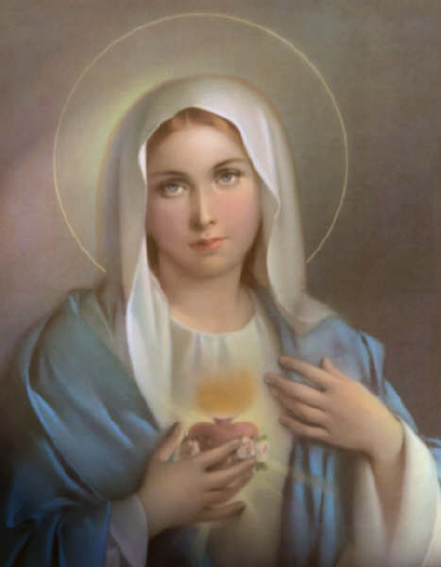
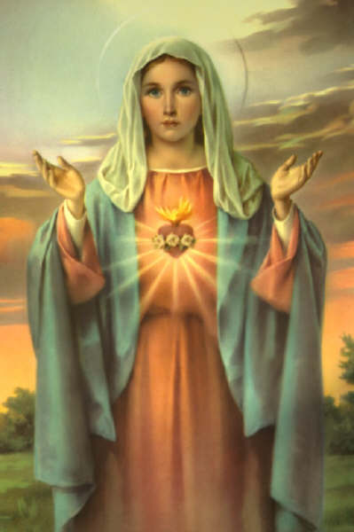
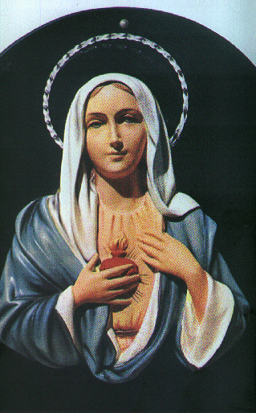
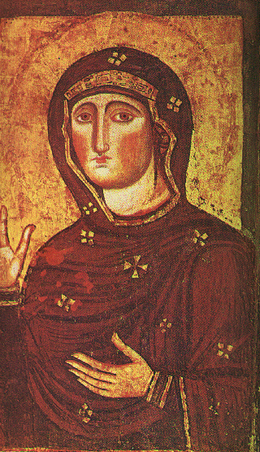
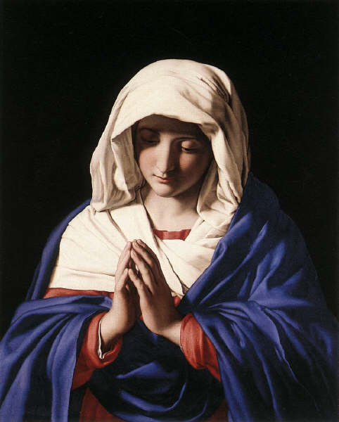

Slide 27
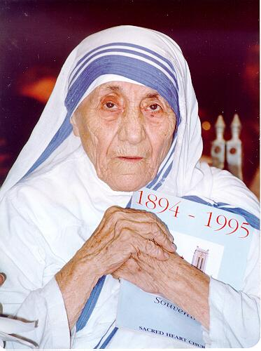
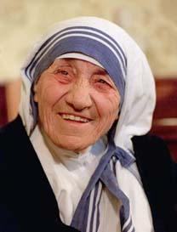
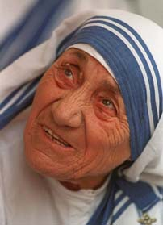

Slide 28
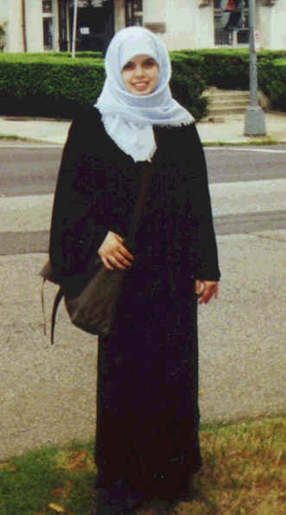
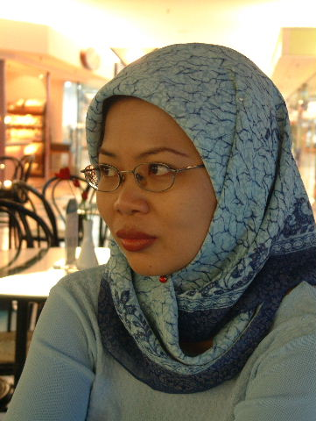
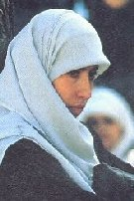
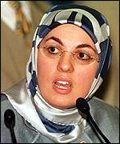
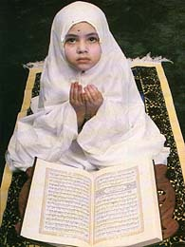
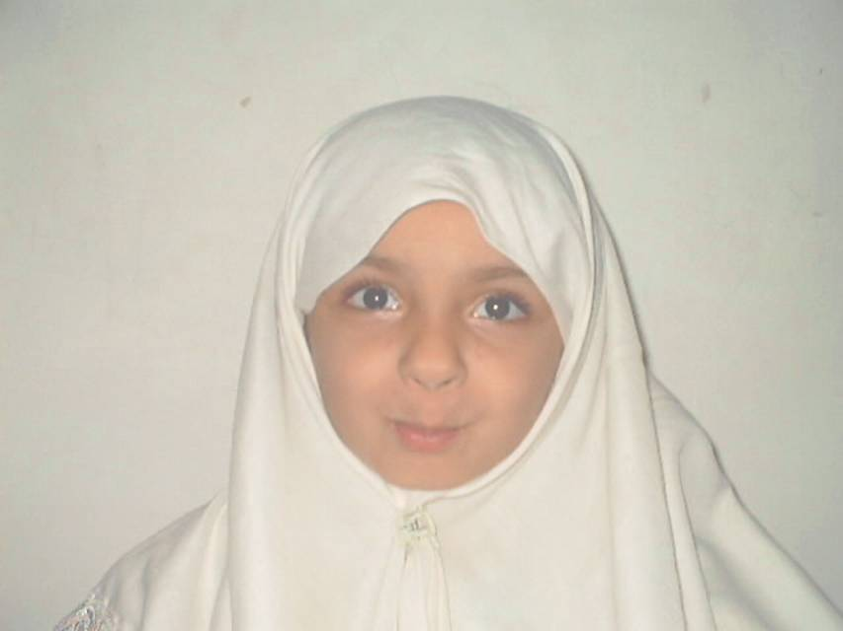
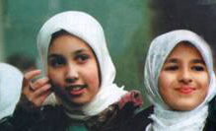

Slide 30
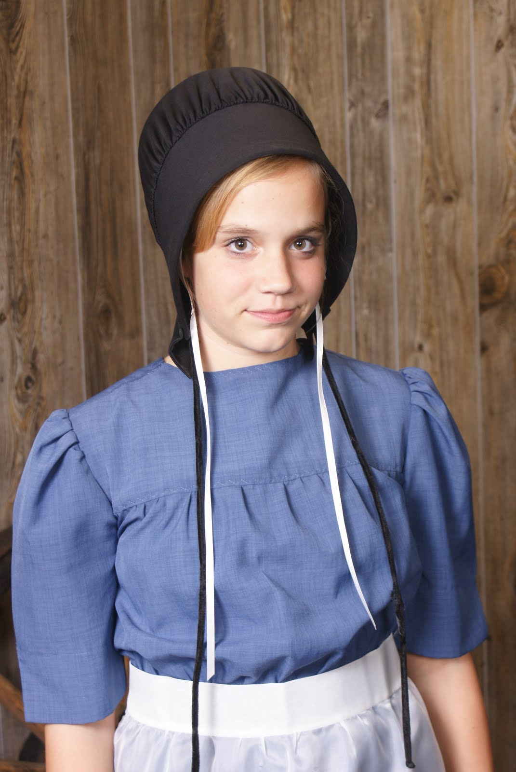
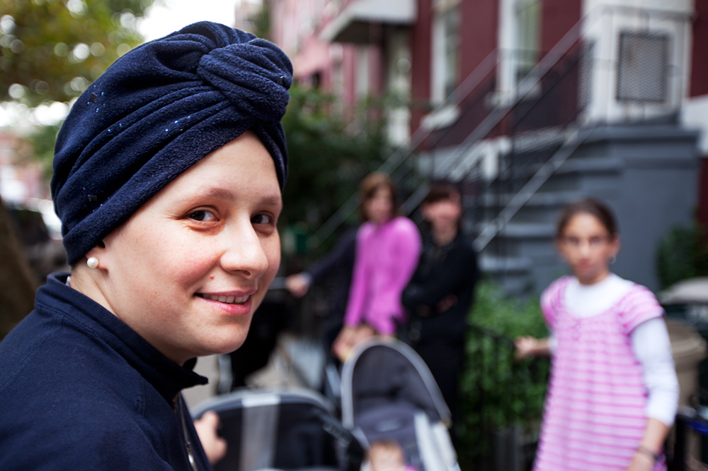
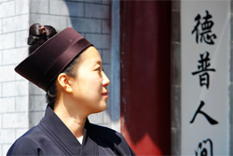
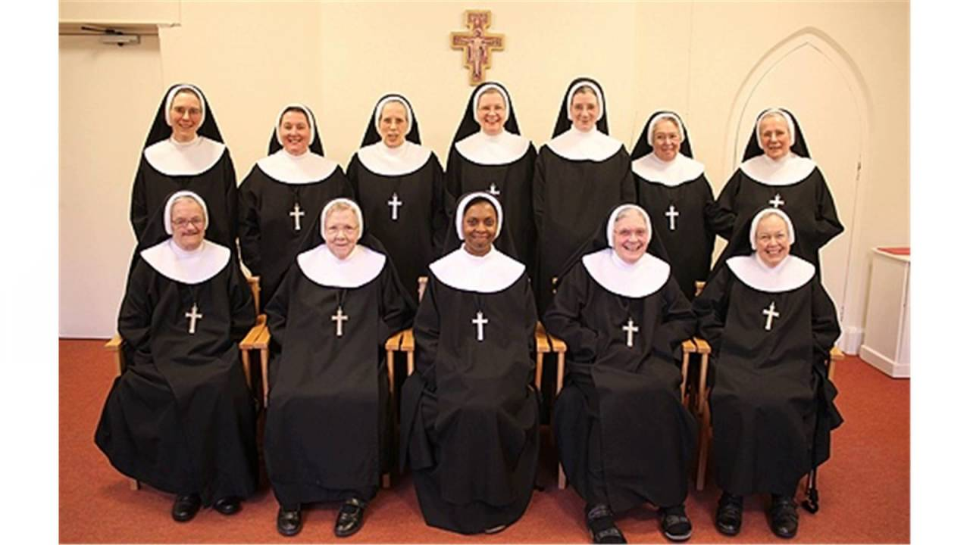
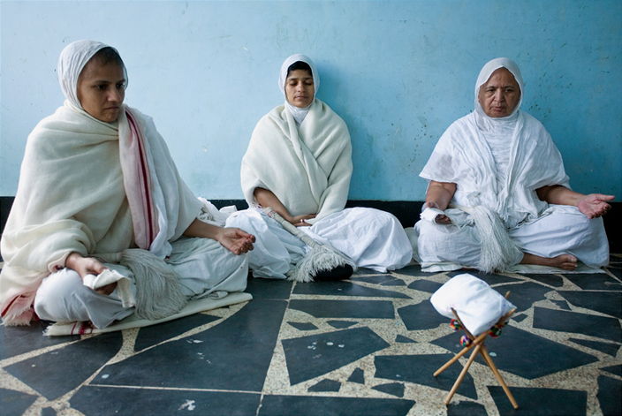
Daoist Nun
Amish
Orthodox Jewish
Catholic
Jain Nuns

Slide 31
HIJAB FAQ's
Women are not forced to wear hijab by Islam, it is an act of worship.
Many women wear hijab in spite of family pressures not to.
Not everyone who wears hijab is foreign.
No... women are not bald under hijab.
No...women do not shower with it on.
Yes, women do have bad hijab days...and yes it's much worse than a bad hair day :)
We live in Texas, so yes its hot, everyone is hot when its 110 degrees outside but its ok :)

Slide 32
Q&A

